Slide 1
WELCOME TO
Supporting Collaboration and Structural Change to Support the Military-Connected Student
Bob James
October 20, 2020
2:30pm

Slide 2
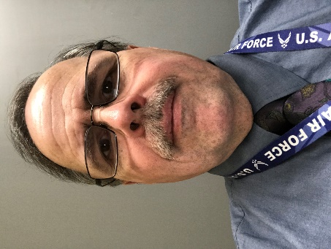
About the Presenters
Bob James
Henry Ford College

Slide 3
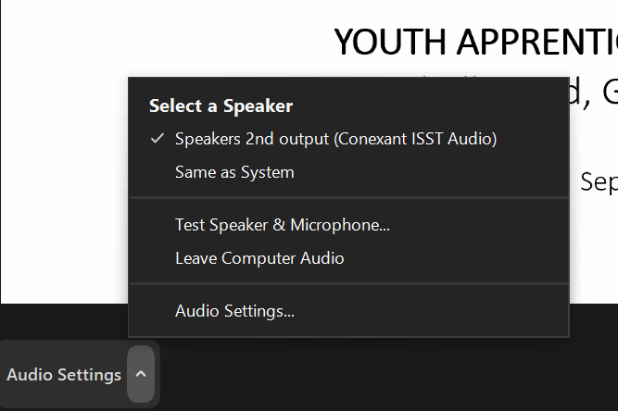
Zoom Webinar
Audio Video

Slide 4
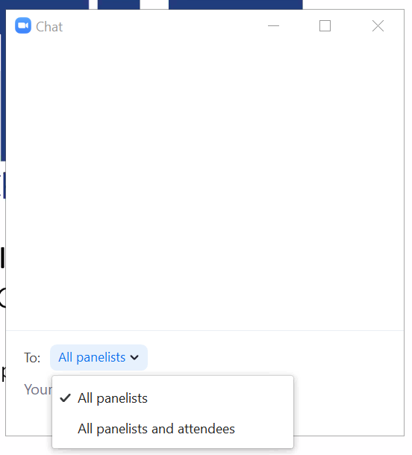
Zoom Webinar
Chat Raise Hand

Slide 5
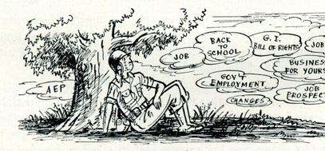
Image courtesy National World War II Museum.
A "veteran" -- whether active duty, discharged, retired, guard or reserve -- is someone who at one point in his or her life,
wrote a blank check made payable to "The United States of America," for an amount of "up to and including his or her life."
Supporting Collaboration and Structural Change to Support the Military-Connected Student
2020 SC Technical College
Notes:
feel free to ask questions throughout

Slide 6
Robert James
Instructor,
Computer Information Systems,
School of Business, Entrepreneurship and Professional Development Henry Ford College Air Force Veteran
Notes:
Each intro self

Slide 7
Session Outline
Welcome & Introductions
Who are Military-Connected Students?
Michigan’s “No Wrong Door” Approach to Serving Veterans Collaboratively Across the State
Military Equivalency
Open Discussion
Reference Slides – Tools & Resources for Extended Learning
Notes:
Bob

Slide 8
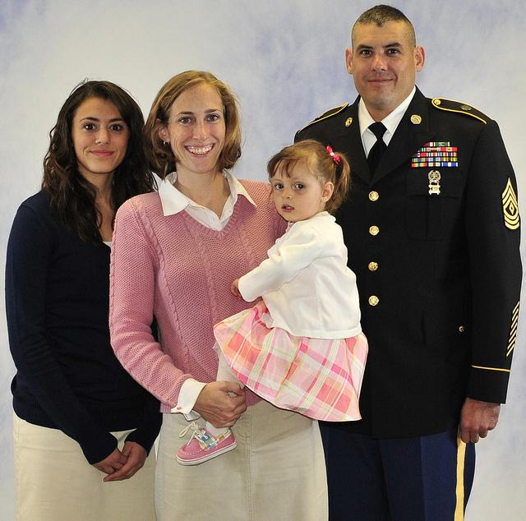
Who are military connected students?
Children
Soldier
Sailor
Airman
Marine
This Photo by Unknown Author is licensed under CC BY-NC
Spouse
This Photo by Unknown Author is licensed under CC BY
Notes:
Julie- my family story

Slide 9
NICOLA M. WINKEL, MPA
16 MAY 2017
“No Wrong Door” Approach to Serving Veterans
Too often the desire to provide services to deserving
Veterans stops at a “Wrong Door”
When there is “No wrong door”
Service Collaboration, Coordination and Integration is achieved
And Services are DELIVERED
Source: Michigan Veterans Affairs Agency (MVAA)
Notes:
expand “veteran” services to military-connected students

Slide 10
MVAA Veteran-Friendly Schools Program Criteria
Gold Level: Complete 6
1. Established process for identification of current student veterans.
2. Veteran-specific website.
3. Active student-operated veterans club or association.
4. Veteran-specific career services, resources, advising and/or outcome monitoring
5. On-campus veteran’s coordinator and/or designated staff point of contact.
6. System to evaluate and award credit based on prior military training and experience.
7. Monitoring and evaluation of student veteran academic retention, transfer and graduation rates.
Silver Level: Complete 4
Bronze level: Complete 3
Source: Michigan Veterans Affairs Agency (MVAA)
Notes:
Julie 1. Established process for identification of current student veterans.
2. Veteran-specific website.
3. Active student-operated veterans club or association.
4. Veteran-specific career services, resources, advising and/or outcome monitoring
5. On-campus veteran’s coordinator and/or designated staff point of contact.
6. System to evaluate and award credit based on prior military training and experience.
7. Monitoring and evaluation of student veteran academic retention, transfer and graduation rates.

Slide 11
Veteran-Friendly Employer Program Criteria
Hiring veterans is not only the right thing to do, it also makes good business sense. Veterans bring skills, an outstanding work ethic and a solid foundation of values to the workplace and become highly productive employees.
By becoming a MVAA Certified Veteran- Friendly Employer, we are declaring to the veteran community that we recognize the importance of hiring veterans and we pledge to uphold the following agreement:
We will actively seek out veteran applicants and encourage them to seek employment with our organization.
We will educate our managers and supervisors on the value of hiring veterans, and provide them with the tools they need to effectively manage veteran employees.
We will continually recognize and support our country's veterans and their families in appreciation for their service and sacrifice to our county.
Gold Level
Silver Level
Bronze level
Source: Michigan Veterans Affairs Agency (MVAA)
Notes:
Julie 1. Established process for identification of current student veterans.
2. Veteran-specific website.
3. Active student-operated veterans club or association.
4. Veteran-specific career services, resources, advising and/or outcome monitoring
5. On-campus veteran’s coordinator and/or designated staff point of contact.
6. System to evaluate and award credit based on prior military training and experience.
7. Monitoring and evaluation of student veteran academic retention, transfer and graduation rates.

Slide 12
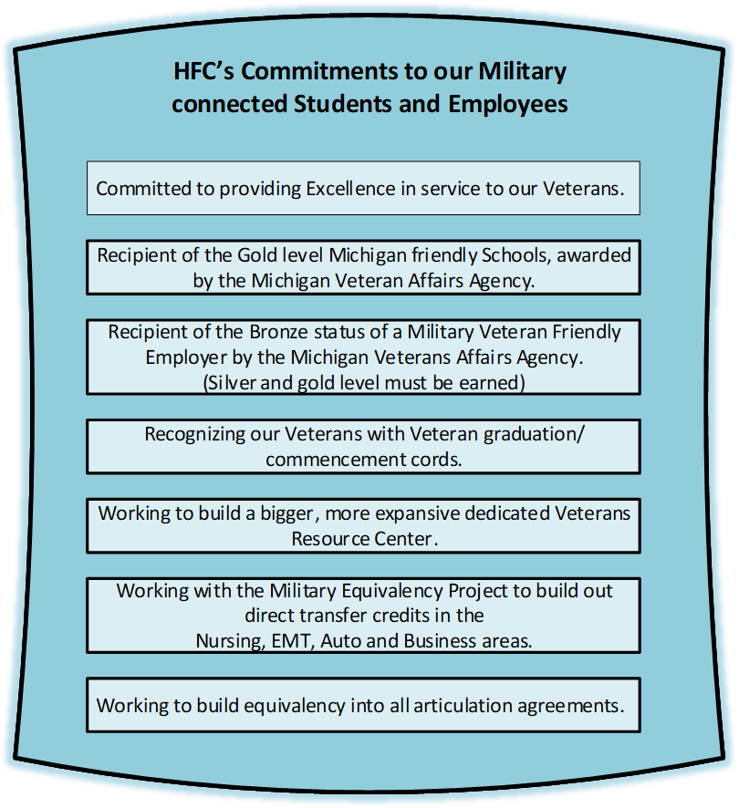
Notes:
BJ

Slide 13
HFC is firmly committed to meeting the personal and educational needs of our veterans, active duty students, their spouses and dependents and active duty military personnel. It’s very important to provide services to help our student succeed and to provide an environment that encompasses the comradery that’s instilled within our Military members. HFC is proud to have a very active Student Veterans Association. We also work closely with the SVA at the University of Michigan Dearborn. The SVA strives to support Student Veterans and their local community. Recent work accomplished by the HFC SVA: Dedication of trees around campus on Veterans day Fund raising for local charities Toys for Tots campaign
Notes:
BJ

Slide 14
Discussion: What makes a campus truly
?
Notes:
BJ facilitate discussion

Slide 15
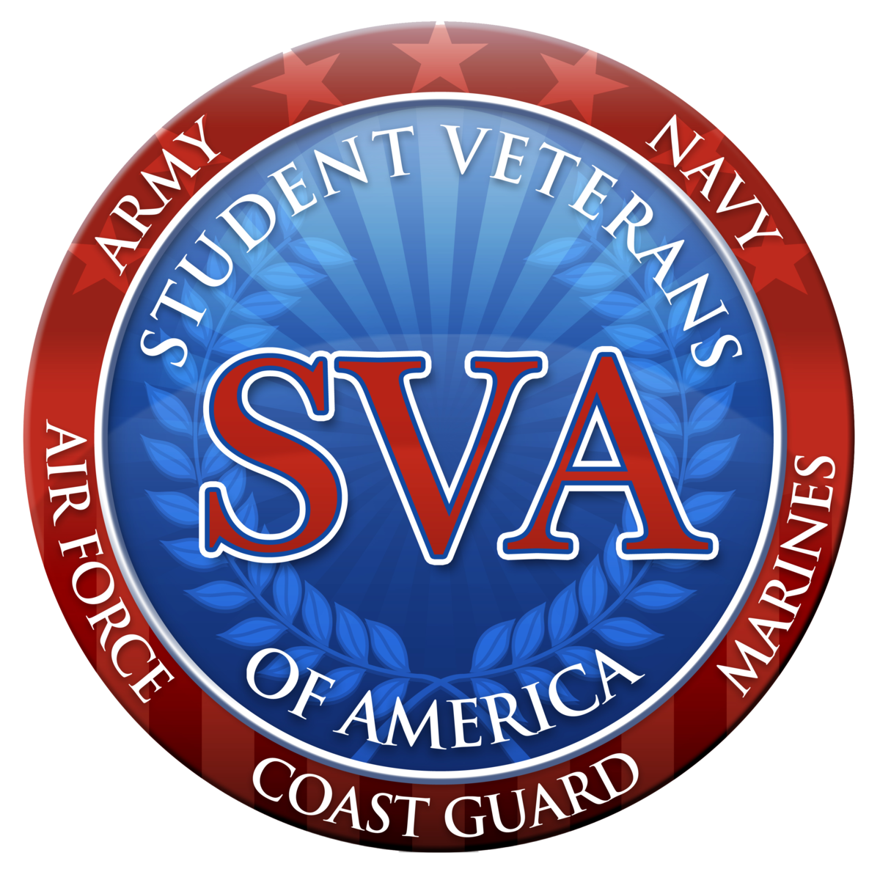
Statewide Efforts in Michigan

Slide 16
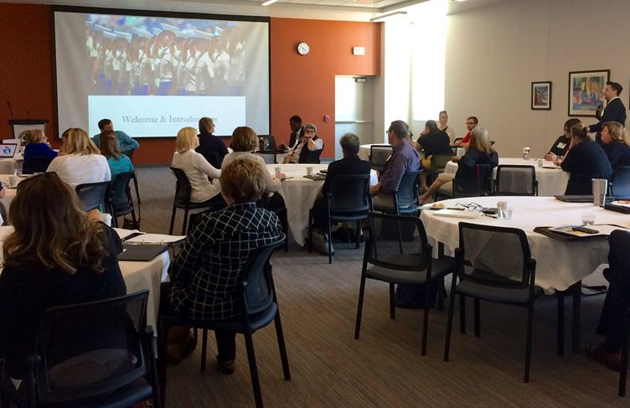
CMVE Organizational Structure
Academic Credit
SVA/Student Veteran Support
Board of Directors
Outreach & Strategic Partnerships
School Certifying Officials (SCO) Support
Post-Military Career Success
Notes:
BJ
Notes: Representative leadership team integrated with active practitioner-led knowledge communities
Member Engagement
Outreach website and member listserv
Social media: www.facebook.com/CMVE10
Attend events:
June 2, 2018 Student Vet Leadership Symposium
Sept. 2019 7th Annual Conference, OU
Virtual events: https://micmve.org/webinars/

Slide 17
Mission: To serve all Michigan public community colleges and universities in their efforts to support military-connected students.
2015-2018 $500K Grant Award
Notes:
BJ

Slide 18
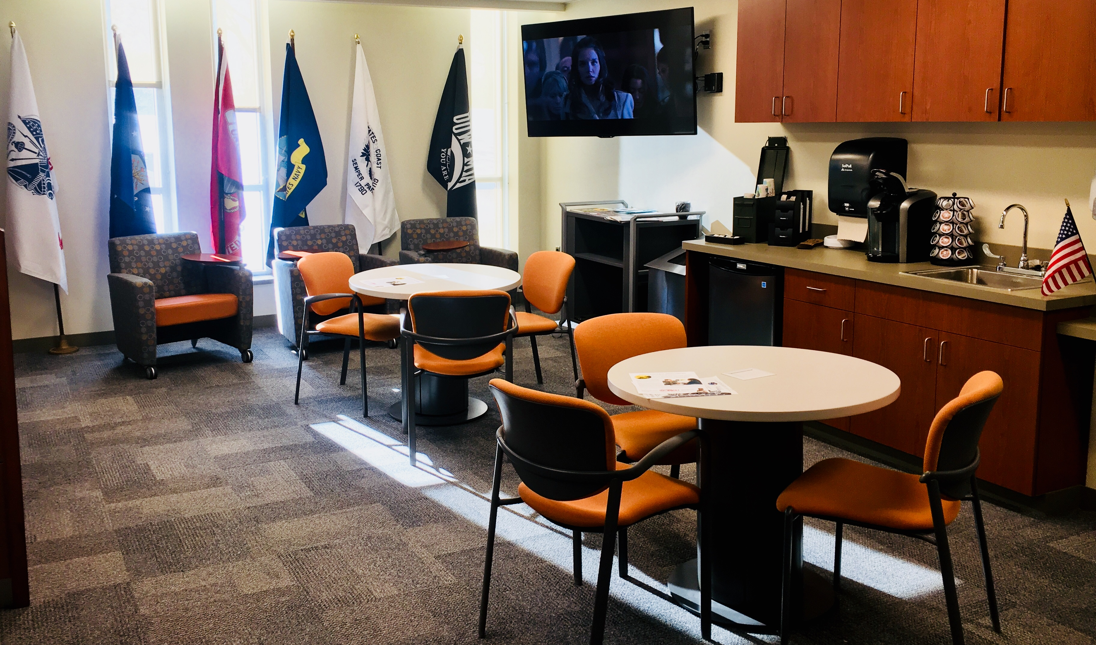
Transfer & University Center
Transfer
225 Transfer Plans
125 Articulation Agreement
2 Concurrent Enrolment Platforms
Reverse Transfer
Macomb University Center
Opened in 1991
4-building complex
175,000 students since it’s opening
12 partners offer 75+ programs
Medical School
Partners are VMS Point of Contacts.
Notes:
KG

Slide 19
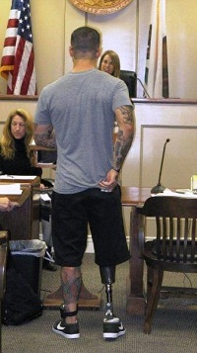
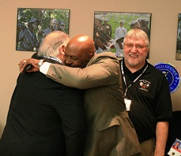
Veterans Treatment Court

Slide 20
Veterans Treatment Court
Most veterans are strengthened by their military service, but the combat experience has unfortunately left a growing number of veterans with issue such as PTSD and traumatic brain injury.
One in five veterans has symptoms of a mental health disorder or cognitive impairment.
One in six veterans who served in Operation Enduring Freedom and Operation Iraqi Freedom suffer from a substance use issue.

Slide 21
Veterans Treatment Court
Research continues to draw a link between substance use and combat-related mental illness. Left untreated, mental health disorders common among veterans can directly lead to involvement in the criminal justice system.

Slide 22
Academic Pathways for Veterans
Campuses developing direct equivalencies, considering credit reciprocity agreements and locally articulated pathways
General Education
Streamlined veteran's portfolio or other PLA supplements; Int’l/Global Diversity for deployment; U.S. Diversity for service; Foreign Language credit for language expertise, direct credit for DLI courses; Communications, Leadership, Management depending on rank; PE/Wellness
Military science or other minors geared toward veterans
MOS “block” credit awards toward accelerated programs
Next state project: METC Degree Bridge Programs
Campus programs: HFC in association with Rochester University
Consortial/pathway agreements, example:
68W → Paramedic → RN/ADN → BSN Completion
Notes:
KG (RM chime in on healthcare pathways)

Slide 23
What’s the impact on accreditation?
HLC Criterion 4. Teaching and Learning: Evaluation and Improvement The institution demonstrates responsibility for the quality of its educational programs, learning environments, and support services, and it evaluates their effectiveness for student learning through processes designed to promote continuous improvement.
A2 - The institution evaluates all the credit that it transcripts, including what it awards for experiential learning or other forms of prior learning, or relies on the evaluation of responsible third parties.
A3 - The institution has policies that assure the quality of the credit it accepts in transfer.
B1- The institution has clearly stated goals for student learning and effective processes for assessment of student learning and achievement of learning goals.
B2 - The institution assesses achievement of the learning outcomes that it claims for its curricular and co-curricular programs.
Source: http://www.hlcommission.org/Policies/criteria-and-core-components.html
Notes:
KG – Open for discussion?

Slide 24
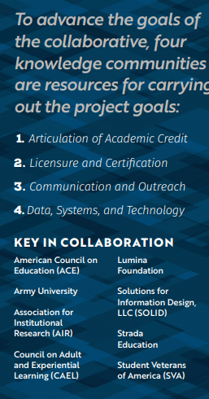
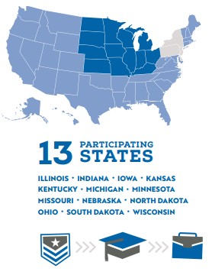
Ref: https://www.mhec.org/convening/multi-state-collaborative-military-credit

Slide 25
MI-litary Equivalency Project (MEP) Goals
Build institutional capacity to establish direct transfer equivalencies ACE credit recommendations on JST.
1.
Support institutions in articulating military training and experience to general and technical education requirements, and building equivalencies for specific Military Occupational Specialties (MOSs).
2.
Showcase developed equivalencies in institutional and statewide transfer equivalency databases.
3.
Notes:
Julie

Slide 26
Define Programs for Equivalency
Explore Programs for Equivalency
Compare Curriculum for Equivalency
Develop Agreements for Equivalency
1
2
3
4

Slide 27
MEP Initial Survey – Areas of Emphasis
(October 2016)
Explore
Active duty enlisted personnel by broad occupational group and branch of military
Active duty enlisted personnel by broad occupational group and branch of military
Notes:
Julie- consider programs you already have and ask if the military might have a comparable program
Kirtland started with medical
METC visit

Slide 28
Table 1. Active duty enlisted personnel by broad occupational group and branch of military, and Coast Guard, May 2015
Enlisted | Army | Air Force | Coast Guard | Marine Corps | Navy | Total enlisted
Occupational group
Administrative | 6,140 | 14,046 | 1,507 | 12,018 | 18,635 | 52,346
Combat Specialty | 109,625 | 677 | 649 | 39,350 | 8,388 | 158,689
Construction | 15,313 | 5,195 | — | 6,252 | 3,987 | 30,747
Electronic and Electrical Equipment Repair | 31,051 | 29,310 | 4,341 | 16,822 | 48,236 | 129,760
Engineering, Science, and Technical | 43,567 | 49,162 | 1,256 | 26,917 | 39,611 | 160,513
Healthcare | 29,986 | 15,441 | 707 | — | 25,345 | 71,479
Human Resource Development | 16,558 | 7,720 | 1 | 2,214 | 3,941 | 30,434
Machine Operator and Production | 4,107 | 6,063 | 1,688 | 2,539 | 8,542 | 22,939
Media and Public Affairs | 6,646 | 7,095 | 136 | 2,439 | 3,859 | 20,175
Protective Service | 21,802 | 32,573 | 2,720 | 6,096 | 12,011 | 75,202
Support Service | 9,901 | 4,981 | 1,145 | 2,263 | 8,129 | 26,419
Transportation and Material Handling | 48,096 | 27,840 | 9,879 | 23,213 | 37,709 | 146,737
Vehicle and Machinery Mechanic | 45,344 | 41,555 | 5,532 | 21,511 | 47,353 | 161,295
Non-occupation or unspecified coded personnel | 2,984 | 5,038 | 1,439 | 1,161 | 2,555 | 13,177
Total enlisted personnel for each military branch and Coast Guard | 391,120 | 246,696 | 31,000 | 162,795 | 268,301 | 1,099,912
SOURCE: U.S. Department of Defense, Defense Manpower Data Center
Notes:
Discuss limitations to data access on separating servicemembers; partnerships with DoD’s transition support units to get information out

Slide 29
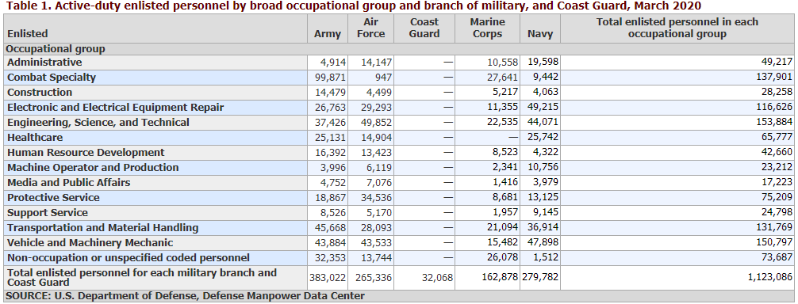

Slide 31
NVEST – National Veteran Education Success Tracker Student Veterans of America (SVA), 2017
1st comprehensive, in-depth study of the academic success of contemporary student veterans using the Post-9/11 GI Bill
Collaborative effort between VA, SVA, and NSC (National Student Clearinghouse)
Multiple completion rates are given. Effectively, 42% of veterans using GI Bill benefits completed a degree (up from 39% of typical students 24+ as found in a 2015 NSC study)
Source: Cate, C.A., Lyon, J.S., Schmeling, J., & Bogue, B.Y. (2017). National Veteran Education Success Tracker: A Report on the Academic Success of Student Veterans Using the Post-9/11 GI Bill. Student Veterans of America, Washington, D.C.. Retrieved from http://nvest.studentveterans.org/wp-content/uploads/2017/02/NVEST-Report_FINAL.pdf
Notes:
KG

Slide 32
2.9 Million Veterans of the post 9/11 Generation have entered higher education after service
82% are Enlisted
Most are between the ages of 25 to 34 (43%), and come from a host of different backgrounds and cultures.
Source: Cate, C.A., Lyon, J.S., Schmeling, J., & Bogue, B.Y. (2017). National Veteran Education Success Tracker: A Report on the Academic Success of Student Veterans Using the Post-9/11 GI Bill. Student Veterans of America, Washington, D.C.. Retrieved from http://nvest.studentveterans.org/wp-content/uploads/2017/06/I-AM-A-POST-911-Student-Veteran-REPORT.pdf

Slide 33
Most likely a member of the U.S. Army (47%).
The Navy (18%)
The Air Force (21%)
The Marine Corps (12%)
The Coast Guard (2%)
The National Guard or the Reserves (45%)
Source: Cate, C.A., Lyon, J.S., Schmeling, J., & Bogue, B.Y. (2017). National Veteran Education Success Tracker: A Report on the Academic Success of Student Veterans Using the Post-9/11 GI Bill. Student Veterans of America, Washington, D.C.. Retrieved from http://nvest.studentveterans.org/wp-content/uploads/2017/06/I-AM-A-POST-911-Student-Veteran-REPORT.pdf

Slide 34
NVEST – National Veteran Education Success Tracker
Source: Cate, C.A., Lyon, J.S., Schmeling, J., & Bogue, B.Y. (2017). National Veteran Education Success Tracker: A Report on the Academic Success of Student Veterans Using the Post-9/11 GI Bill. Student Veterans of America, Washington, D.C.. Retrieved from http://nvest.studentveterans.org/wp-content/uploads/2017/02/NVEST-Report_FINAL.pdf
Notes:
KG

Slide 36
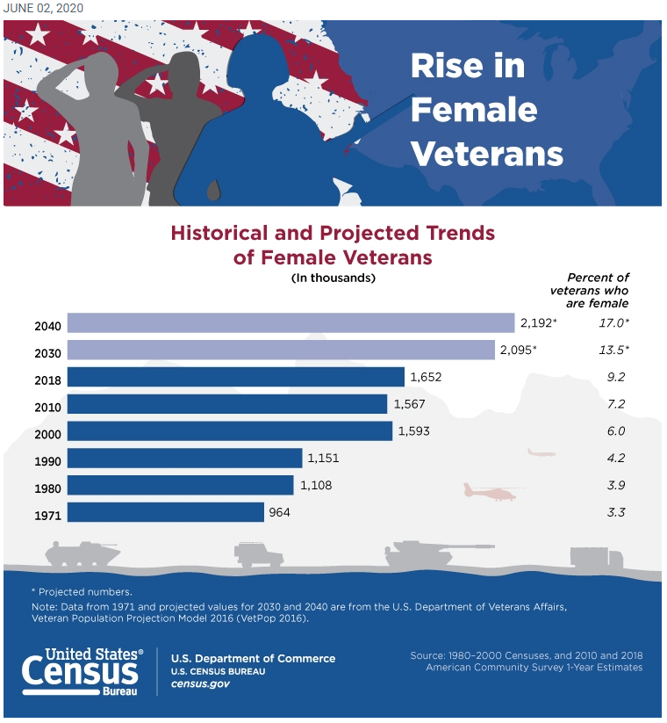

Slide 37
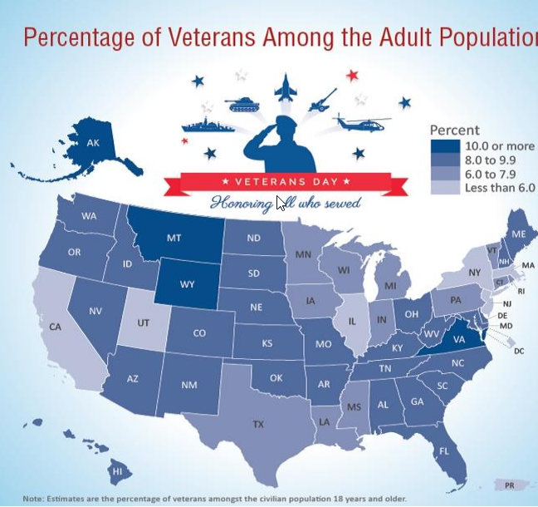

Slide 38
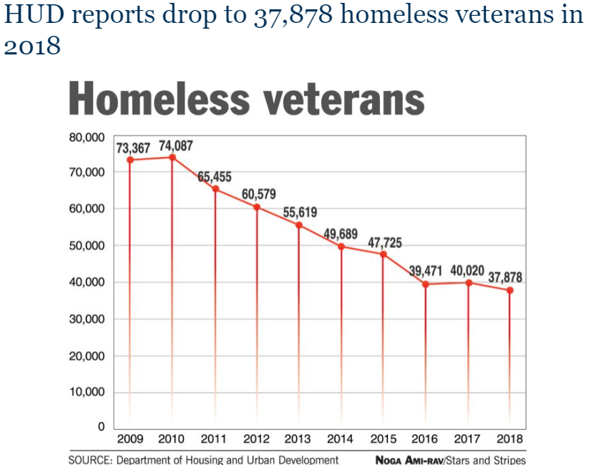

Slide 39
Who are Michigan’s Veterans?
Find your states’ info: https://www.census.gov/library/visualizations/2015/comm/veterans-statistics.html
Notes:
KG

Slide 40
EquEE
Equivalency Agreements
METC Degree Bridge

Slide 41
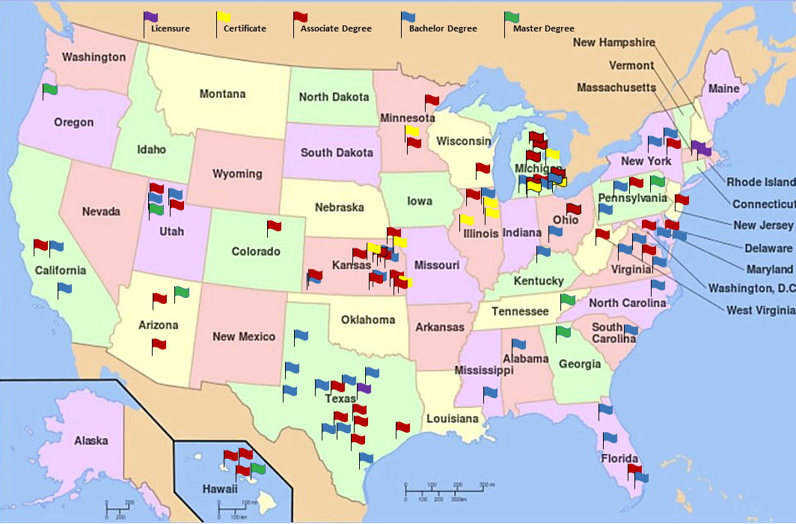

Slide 42
Notes:
Julie- define programs for equivalency. Start simple.
Surg tech good starting point because of accreditation

Slide 43
Scaling Concepts Discussed Today (aka Lessons Learned)
Find your champions
This usually starts from the ground (grassroots) but executive leadership buy-in is critical to advancing this work
In education: This work is not confined to “veterans services” or the certifying official – a truly authentically military-friendly campus is an interdepartmental effort
Start small – a listserv or “town hall meeting” can be effective places to start and then build on mutual goals
Think about funding sources
Let your student veterans help you lead – they are ready!
Notes:
We can each take 2 to discuss?

Slide 44
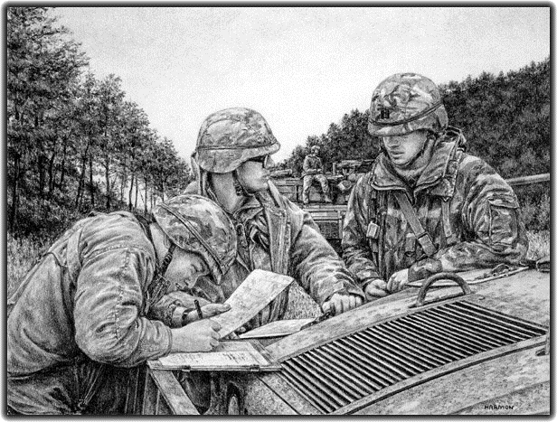
Open Discussion
Artist: Jody Harmon http://www.jodyharmon.com/
Notes:
Open Discussion/Q & A

Slide 45
Reference Slides –
Tools & Resources for Extended Learning
Notes:
Not covered in session – just for reference after

Slide 46
Building Institutional Capacity to Serve Military-Connected Students
Form and convene campus work group
Ensure common language
Assess student experience
Military competency crosswalks

Slide 47
Form and Convene Campus Workgroup
Use existing or form new interdepartmental veteran success group to maximize student veteran success on your campus
Get the right people involved: records/registrar, admissions, financial aid, student services, veteran services, school certifying official, student veteran leaders, VETERAN ADVOCATES
Hold initial in-service or strategy sessions
Schedule regular follow-up meetings

Slide 48
Assess Military-Connected Student Experience
Consider data projects –
What is your student veteran enrollment? What’s the 5-year trend?
In which academic programs are military-connected students frequently enrolling in?
Can you query within your SIS or transfer credit database to see what military credit awards have been made in the last 5 years?
What can you learn about the JST credit that commonly comes in to your institution?
What else do you want to know to inform your efforts?
Talk with veterans about their experiences – they are ready to lead!

Slide 49
Ensure Common Language
Be sure your work group knows basic military terms and understands how to maximize information found on JST
Explore these resources and hold follow up discussion during your work group in-service or regular meetings
Obtain a Joint Services Transcript (JST) (student-facing website to request JST)
JST FAQs (follow advanced prompt to overcome DoD security check; great basic info here)
Academic Credit for Military Experience: A Closer Look at the Issues and Strategies for Increasing Capacity on Your Campus – video, slides (Katie Giardello, MCSS, webinar)
ACE Transcripts for Military Personnel (ACE resource links and archived webinar)
Faculty Evaluation Process (ACE overview of faculty review that determines credit recommendations)

Slide 50
The Alphabet Soup of Awarding Credit for Military Experience
DoD - Department of Defense
DANTES - Defense Activity for Nontraditional Education Support
VA – U.S. Department of Veterans Affairs
SAA – State Approving Agencies
SCO – School Certifying Officials
DD-214
JST - Joint Services Transcript (don’t be worried about security warning!)
MOS – Military Occupational Specialty
CCAF - Community College of the Air Force
AU - Air University
Army U

Slide 51
The Alphabet Soup of Awarding Credit for Military Experience
PLA - Prior Learning Assessment
CPL - Credit for Prior Learning
ACE - American Council on Education
ACE Military Evaluations
CAEL - Council on Adult and Experiential Learning
Academic and Career Success for Veterans

Slide 52
VA Benefits – Educational Benefits
Many benefits are available to advance the education and skills of Veterans and Servicemembers. Spouses and family members may also be eligible for education and training assistance in fact, 25 percent of those benefitting from VAs education programs are non-Veterans. Some might find they're eligible for more than one benefit or that one program is more suited to certain education and training goals than another. Learn about these and other education and training programs administered by VA:
The Post-9/11 GI Bill offers higher education and training benefits to Veterans, Servicemembers, and their families who served after Sept. 10, 2001. The “Forever GI Bill” was signed into law in December 2017 and has major implications for VA benefit users as well as institutions that receive these benefits.
The Montgomery GI Bill assists active duty and Reservists with the pursuit of higher education degrees, certificates, and other education and training.
These other VA education and training programs offer various education and training benefits or increased benefits to certain Reservists and Veterans and their survivors and dependents:
Reserve Educational Assistance Program
Veterans Educational Assistance Program
Survivors and Dependents Educational Assistance Program
National Testing Program
National Call to Service Program

Slide 53
Source: http://studentveterans.org/2-uncategorised/669-forevergibill

Slide 54
VA Benefits – Vocational Rehabilitation & Employment (aka VR&E, Voc Rehab, Chapter 31)
Veterans may receive Vocational Rehabilitation and Employment (VR&E) services to help with job training, employment accommodations, resume development, and job seeking skills coaching. Other services may be provided to assist Veterans in starting their own businesses or independent living services for those who are severely disabled and unable to work in traditional employment.
Eligibility Requirements
VetSuccess on Campus (VSOC)
VA's Education and Career Counseling program is a great opportunity for Veterans and Servicemembers to get personalized counseling and support to help guide their career paths, ensure the most effective use of their VA benefits, and achieve their goals. Learn more and apply for education and career counseling.

Slide 55
Regulatory Complexities
State Approving Agencies (SAA)
SAAs grant approval of VA-eligible education and training programs
Veterans Access, Choice and Accountability Act of 2014
See provisions for schools under the newly passed Forever GI Bill
Federal Aid Regulations
SAP/150% rule
90/10 → 85/15 rule for VA beneficiaries
VA processes can implicate bursar practices

Slide 56
Military Competency Crosswalks
ACE Military Guide
This interactive database shows credit recommendations for courses and occupations offered by all branches of the military that have been evaluated by ACE since 1954.
MCMC bridge program inventory
This spreadsheet shows examples from institutions in the 13 Multi-State Collaborative on Military Credit states where credit is awarded (usually in block) toward programs that align with particular Military Occupational Specialty (MOS)
MN VETS database
Query to see what credit awards are offered in the MN system for particular MOSs
Armed Forces Credentialing Opportunities On-Line (COOL)
Air Force COOL
Army COOL
Marine Corps COOL
Navy COOL

Slide 57
Archived MI-litary Equivalency Project materials. Highlighted resources:
Building Campus Strategy for the MI-litary Equivalency Project. Click here for web recording.
The ACE Review Process- Insights from MI Faculty. Click here to access the event recording (please note: You may be given the option to select “Playback” or “Download.” Playback will allow you to stream the recording, while download will allow you to download the recording. If selecting the “playback” option, you must allow Cisco WebEx access to your computer. If selecting the “download” option, you must download the WebEx ARF player as prompted.)
MI-litary Equivalency Project Campus Planning Seminar, featuring Dr. Patricia Brewer, Midwest Regional Liaison, Center for Education Attainment and Innovation, American Council on Education. Click here to access the slide deck used during this program. Click the links below to access the handouts from the Seminar: MEP Seminar Agenda
Credit-for-Prior-Learning-Infograp
ACE_CorrespondingExhibit
Coast-Guard-Sample-JST (1)
MEP Campus Planning Guide
Pre-Conference Program: Military Credit Mapping Summit. Click here to review the agenda for this program. This slide deck incorporates the following presentations: American Council on Education (ACE) Translation Exercise; ACE Deep Dive – Faculty Review, JST credit, Exploration of ACE Tools (Breakout session), Dr. Patricia Brewer, Midwest Regional Liaison, Center for Education Attainment & Innovation, American Council on Education; Dr. Lisa Ferris-McCann, Associate Director, Military Programs, American Council on Education

Slide 58
Michigan’s digital resource repository recommended for campus use in developing direct credit maps. Highlighted resources:
American Council on Education (ACE) Handouts
MI_Sept2017_Mapping_Prework_Resources (003)
Mapping ACE Military Credit Recom.
ACETerms and Definitions(16Jan15)
Skill Level Pay Grade and Rank Def.
Ivy Tech Community College of Indiana Military Training and Certification Crosswalk
Kansas Board of Regents Credit for Military Alignment (click to see articulations for: general education, fire science, business administration, information technology, criminal justice, human resource management, surgical technology, physical therapy assistant, medical office assistant, medical coding, medical laboratory technology, nursing, automotive technology, culinary arts, and more as they are developed).
Minnesota State Shared Resources
MNAcceleratedProcess_February2017 (describes the process used by faculty in MN)
Blank worksheets to support bulk mapping by discipline: MCMC_MasterCopyVETSWorkbook
Completed articulations in MN State: MN VETS Articulations Book 1 Aug 2016, MN VETS Articulations Book 2 Aug 2016

Slide 59
2020 TLT Sessions
November – Rural Issues, Dr. Marci Rockey, OCCRL
December – No TLT Session
January – State of the Division + 2021 Topic Schedule Released
Want to showcase your expertise? Is there a teaching technique that has been effective in the classroom? Apply to be a TLT presenter!
For more information and full schedule: www.sctechsystem.edu/tlt

Slide 60
Give Us Your Feedback
https://www.surveymonkey.com/r/Oct2020TLT

